Slide 1
DEP IN
DEPTH
And other stuff too

Slide 2
Bypassing DEP is not new

Slide 3
Bypassing DEP is not new
‘ret2libc’ DEP bypass
before DEP was even implemented natively in Windows
http://packetstormsecurity.org/0311-exploits/rpc!exec.c
Released in 2003
NtAllocateVirtualMemory()
Memcpy()
NtProtectVirtualMemory()

Slide 4
Still most public exploits do not bypass DEP
Largely because of default desktop DEP settings
Enable DEP will prevent the majority of public exploits
This is changing
With the current release of methods and techniques
Soon most exploits will bypass DEP
So... Does DEP Work?

Slide 5
DEP 101
Data Execution Prevention
Prevents the execution of code from pages of memory that are not explicitly marked as executable
Enforced by hardware
Attempts to run code from a non executable page result in a STATUS_ACCESS_VIOLATION exception
What does it protect?
DEP is always enabled for 64-bit native programs.
Configuration specifies if DEP is enabled for 32-bit programs.

Slide 6
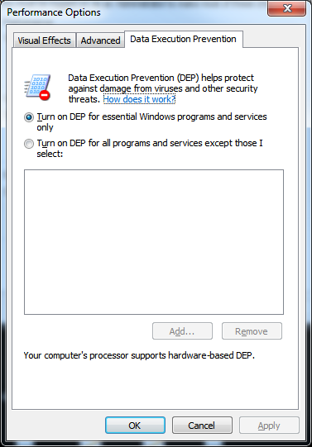
DEP Modes
Opt-In
Process must explicitly decide to enabled DEP
Opt-Out
Every process is protected unless explicitly decides to disable DEP
Always On
All process are always protected and can’t be disabled
Always Off
Disable DEP for everything

Slide 7
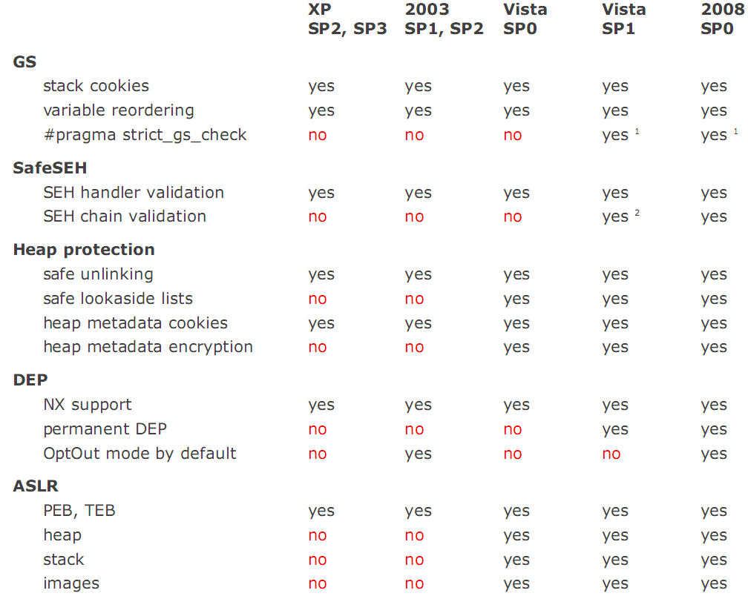
Memory Protection Mechanisms

Slide 8
DEP Protection Mechanisms
 | XP SP2, SP3 | 2003 SP1, SP2 | Vista SP0 | Vista SP1 | 2008 SP0 | Win7 SP0
DEP Support | yes | yes | yes | yes | yes | yes
Permanent DEP | no | no | no | yes | yes | yes
Default OptOut | no | yes | no | no | yes | no
Default AlwaysOn | no | no | no | no | no | no
That's a lot of no
If DEP Is Not Enabled, Then There Is Nothing To Defeat

Slide 9
Opting In/Out
/NXCOMPAT
Linker option use to specify that this process wants DEP
SetProcessDEPPolicy()
Called by process to Opt In/Out and set permanent DEP
Uses Permanent DEP?
SetProcessDEPPolicy(PROCESS_DEP_ENABLE)
DEP setting can not be changed after this call
 | IE 7 | IE 8 | FF 3 | Safari 5
Permanent DEP | no | yes | yes | yes
Independent of OS settings

Slide 10
Disable DEP vs Bypass DEP
Disable DEP
Essentially this is Opt Out for a process
NtSetInformationProcess()
Skape and Skywing ret-to-libc to deactivate DEP
SetProcessDEPPolicy()
On XP SP3 and later
Will not work against
/AlwaysOn
Permanent DEP
NtSetInformationProcess(
NtCurrentProcess(), // (HANDLE)-1
ProcessExecuteFlags, // 0x22
&ExecuteFlags, // ptr to 0x2
sizeof(ExecuteFlags)); // 0x4
From Now On Lets Just Assume /AlwaysOn Permanent DEP Is Enabled

Slide 11
Disable DEP vs Bypass DEP
Bypass DEP
Allocate executable memory to contain shellcode
Various very clever browser attacks
Attack | Defense
.Net User Control DEP Bypass | Internet Explorer 8
Actionscript Heap Spray | Flash 10 (DEP/ASLR)
Java Heap Spray | No longer RWX
JIT-Spray | Flash 10.1. pages with code are encrypted
See the AWESOME work released at XCon2010
Defeat Win 7 Browser Protection - XCon2010_win7

Slide 12
Bypass DEP
Bypass DEP with ret2libc
Use executable instructions from the application
Use executable instructions from other dlls
Return Orientated Prog

Slide 13
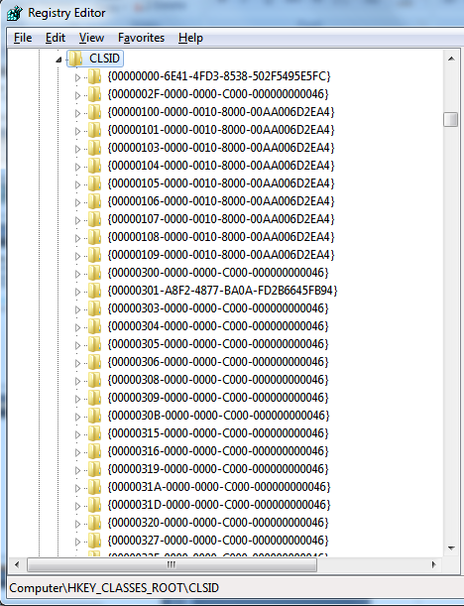
Vista IE7 DEP/ASLR Bypass
CLSID
Reference to .dlls
Loaded in IE
Some Of These Are Not
ASLR/DEP Aware
C:\Windows\System32\
infocardapi.dll

Slide 14
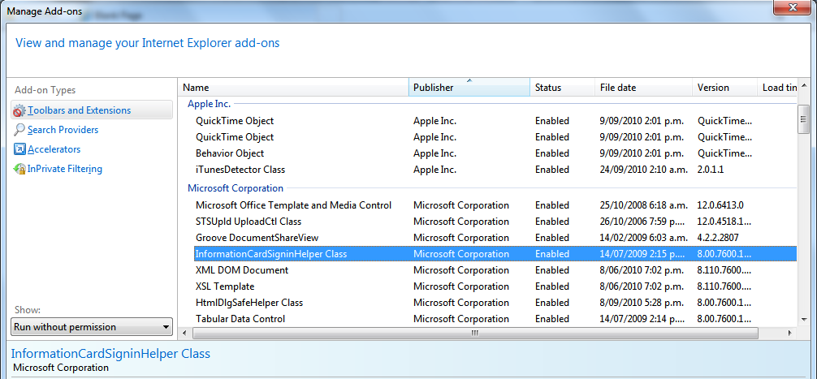
Will load infocardapi.dll
Is safe to run

Slide 15
Gaining EIP
Use the stack to control flow
Function address
Parameters
STACK
...
RETURN ADDRESS1
PARAM1
PARAM2
RETURN ADDRESS2
Overwrite RET directly

Slide 16
Gaining EIP
STACK
...
..
..
Ptr To SEH Record
XXXXXXXX
XXXXXXXX
XXXXXXXX
Ptr To Next SEH Record
Ptr To SE Handler
XXXXXXXX
XXXXXXXX
EIP through SEH overwrite
Well known technique
No more pop,pop, ret
Other pointers to SEH record
Point ESP to our buffer
Reference SEH record
ESP when handler called
ESP | +8 | +14 | +1C | +2C | +44 | +50
EBP | +C | +24 | +30 | -04 | -0C | -18
ADD ESP,### RETN
MOV ECX,[EBP+0C] CALL [ECX]
Overwrite SEH directly

Slide 17
Gaining EIP
EIP through vTable overwrite
Common in browser exploits
Application function call
Need to control the stack
vTable Overwritten
MOV EAX,[ESI] CALL EAX
HEAP
XXXXXXXX
XXXXXXXX
XXXXXXXX
XXXXXXXX
XXXXXXXX
XXXXXXXX
ESI points to vTable
PUSH ECX POP ESP RETN
Exploit points vTable to here

Slide 18
Controlling The Stack
Now we are in control of the stack
Controls execution flow into existing code blocks
Not executing any shellcode yet
Find out where we are
Need to know our ESP address, for local addressing
PUSH ESP POP EAX RETN
MOV ECX,DWORD PTR FS:[0] .. RETN
Load ESP directly
Load ESP indirectly via SEH

Slide 19
DEP Bypass
The easy way
Use LoadLibrary() to retrieve DLL over webdav/smb
DLL is loaded into memory and executed
No memory protection changes required
Points to our string
Return to here
LEA EAX,DWORD PTR SS:[ESP+40] PUSH EAX CALL DWORD PTR DS:[<&KERNEL32.LoadLibrary>]
Calls LoadLibraryA()

Slide 20
HeapCreate()
Create an executable heap to use
HeapCreate(HEAP_CREATE_ENABLE_EXECUTE)
HeapAlloc()
Memcpy
Return to buffer
PAYLOAD
FindSelf
PAYLOAD
FindSelf
HeapCreate()
PAYLOAD
FindSelf
HeapCreate()
HeapAlloc()
PAYLOAD
FindSelf
HeapCreate()
HeapAlloc()
Copy
ShellCodez
PAYLOAD
FindSelf
HeapCreate()
HeapAlloc()
Copy
Ret
ShellCodez
HEAP
...
..
..
HEAP
...
..
HeapChunk
HEAP
...
..
HeapChunk
HEAP
...
..
HeapChunk
ShellCodez

Slide 21
HeapCreate() (Improved)
Create an executable heap to use
HeapCreate(HEAP_CREATE_ENABLE_EXECUTE)
Increase Returned Heap Ptr
Memcpy
Return to buffer
Pointer Returned From HeapCreate()
HEAP Base
...
..
HeapChunk
Increase Pointer To Valid Heap Space
Common In Metasploit Modules By jduck

Slide 22
VirtualAlloc()
Allocate executable memory
VirtualAlloc(NULL,size,PAGE_EXECUTE_READWRITE)
Memcpy
Ret to buffer
PAYLOAD
FindSelf
PAYLOAD
FindSelf
VirtualAlloc()
PAYLOAD
FindSelf
VirtualAlloc()
Copy
Shellcodez
PAYLOAD
FindSelf
VirtualAlloc()
Copy
Ret
Shellcodez
Alloc’d Space
Alloc’d Space
Shellcodez
Alloc’d Space
Shellcodez

Slide 23
VirtualAlloc() (Improved)
Allocate executable memory
VirtualAlloc(findself(),size,PAGE_EXECUTE_READWRITE)
Ret to self
When Committing Memory, VirtualAlloc() Will Modify The Protection Type Of Existing Memory Pages

Slide 24
Memory Protection Attacks
VirtualProtect(PAGE_EXECUTE_READWRITE)
Pass the address of payload
Update to make memory executable
Execute it
WriteProcessMemory()
Write payload to existing executable memory
Can be at the end of WriteProcessMemory()
Payload executed
WriteProcessMemory() Will Modify The Protection Type Of Existing Memory Pages To Be Writeable

Slide 25
Other Attacks
CreateFileMapping()
CreateFileMapping(-1,0, PAGE_EXECUTE_READWRITE)
MapViewOfFile()
MemCpy()
Ret
Others
System()
WinExec()
Etc..
Creates A New Memory Backed Map Of The Existing Process
So... Does DEP Work?

Slide 26
ASLR In Browsers
ROP requires known addresses
ASLR is a problem, only if it is enabled for everything
*coff* Adobe
Firefox 3.6.3
Safari 5
OS | DLL | Address?
Vista | Nspr4.dll 4.8.3 | 0x10000000
Windows 7 | Nspr4.dll 4.8.3 | 0x10000000
OS | DLL | Address?
Vista | libdispatch.dll 1.109..4.1 | 0x10000000
Windows 7 | libdispatch.dll 1.109..4.1 | 0x10000000

Slide 27
3rd Party Components
Shockwave anyone
Java perhaps
Browser | OS | DLL | Address?
IE 7 | Vista | DIRAPI.dll 11.5.7r609 | 0x68000000
 |  | IML32.dll 11.5.7r609 | 0x69000000
 |  | SWDir.dll 11.5.7r609 | 0x69200000
IE8 | Windows 7 | DIRAPI.dll 11.5.7r609 | 0x68000000
 |  | IML32.dll 11.5.7r609 | 0x69000000
 |  | SWDir.dll 11.5.7r609 | 0x69200000
Browser | OS | DLL | Address?
IE 7 | Vista | deployJava1.dll | 0x10000000
 |  | MSVCR71.dll 7.10.3052.4 | 0x7c340000
IE8 | Windows 7 | deployJava1.dll | 0x10000000
 |  | MSVCR71.dll 7.10.3052.4 | 0x7c340000

Slide 28
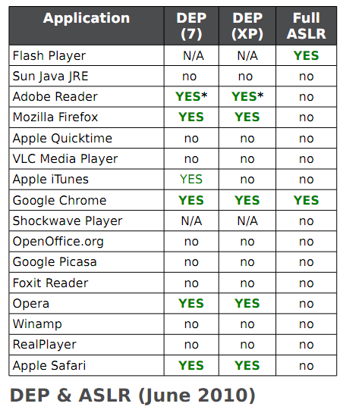
Expanded Chart
Secunia: DEP & ASLR In Popular 3rd party applications.PDF

Slide 29
ASLR
ROP needs only one address
Can use LoadLibrary() to load other DLLS
Can use lookups to reference other DLLS
MOV DWORD PTR DS:[ESI],EDI PUSH ESI CALL DWORD PTR DS:[<&KERNEL32.GetVersionExA>]
MOV DWORD PTR DS:[ESI],EDI PUSH ESI CALL DWORD PTR DS:[6F62C8]
Pointer to function inside Kernel32

Slide 30
Default Heap Memory Protection
Heap Management
Address | Value | Description
00360000 |  | Base Address
0036000C | 00000002 | Flags
Heap structure flags
HeapCreate()
These Flags hold settings such as isDebug, Exception Raising, and Executable Heap
BASE+0x40 on Windows 7
Heap Flags
Name | Value | Description
HEAP_CREATE_ENABLE_EXECUTE | 0x00040000 | All memory blocks that are allocated from this heap allow code execution
HEAP_GENERATE_EXCEPTIONS | 0x00000004 | Raise an exception to indicate failure
HEAP_NO_SERIALIZE | 0x00000001 | Serialized access is not used

Slide 31
Default Heap Memory Protection
Heap is extended to accommodate an allocation request
7C833C50 MOV EAX,DWORD PTR DS:[EAX+C] 7C833C53 AND EAX,40000 7C833C58 NEG EAX 7C833C5A SBB EAX,EAX 7C833C5C AND EAX,3C 7C833C5F ADD EAX,4 7C833C62 PUSH EAX 7C833C63 PUSH 1000 7C833C68 PUSH EBX 7C833C69 PUSH 0 7C833C6B LEA EAX,DWORD PTR SS:[EBP+14] 7C833C6E PUSH EAX 7C833C6F PUSH -1 7C833C71 CALL ntdll.ZwAllocateVirtualMemory
Load flags from heap base
Push flag for use in allocation
If The Flag Can Be Manipulated, It Can Lead To An Executable Heap Allocation

Slide 32
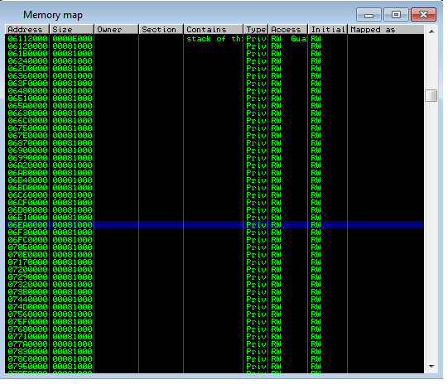
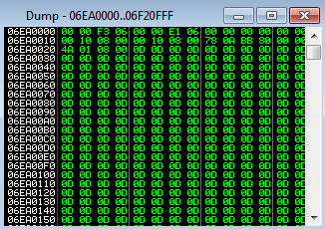
Executable Heap Spray
Heap Management
Address | Value
00360000
0036000C | 00000002
Before flag change

Slide 33
Executable Heap Spray
Heap Management
Address | Value
00360000
0036000C | 00040002
After flag change
Arbitrary byte write used to set heap executable
RWE

Slide 34
SafeSEH
Prevents the abuse of SEH records
/safeseh linker option
Common known weaknesses
Handler in a module not /safseh
Handler not in a loaded module
Handler on the heap
Lets Assume There Are None
STACK
...
RETURN ADDRESS
..
Ptr To Next SEH Record
Ptr To SE Handler
..
..
Ptr To Next SEH Record
Ptr To SE Handler
This is not useful, the heap is not executable!
EXECPTION HANDLER
EXECPTION HANDLER

Slide 35
SafeSEH
Not so common known weaknesses
Existing registered handlers
Mentioned by Litchfield
Dissected by Ben Nagy
Multiple DLLS channel there exceptions through MSVCRT
SETUPAPI.DLL
770f0539
WS2_32.DLL
71C12699
MSVCRT.DLL
77BC6C74 | _except_handler3
77BE8E5B | __CxxFrameHandler2
TAPI32.DLL
76E875F9
OLEAUT32.DLL
77D7E249

Slide 36
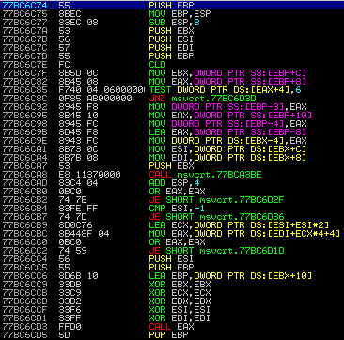
0x77BC6C74 _except_handler3
Visual C++ implementation of SEH
If we can write NULLS to the stack
And we can guess the stack range
And we can spray a heap range
Then yes, we can reach this code
Good Luck With That ☺

Slide 37
0x77BC6C74 _except_handler3
77BC6CA1 MOV ESI,DWORD PTR DS:[EBX+C] ; Load SEH+C 77BC6CA4 MOV EDI,DWORD PTR DS:[EBX+8] ; Load SEH+8 77BC6CA7 PUSH EBX 77BC6CA8 CALL msvcrt.77BCA3BE ; Call validation routine
STACK
SEH-8 | Ptr Stack < SEH
SEH-4 | XXXXXXXX
SEH Record | XXXXXXXX
Handler | 77BC6C74
SEH+8 | NonStack Ptr
SEH+C | 00000001
Fake Record
FFFFFFFF | EIP TARGET
Possible under the right conditions, but yeah.....

Slide 38
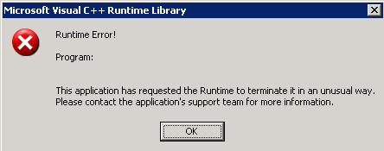
__CxxFrameHandler2
77BE8E5B MOV EAX,msvcrt.77BE8EF0 77BE8E60 JMP msvcrt.__CxxFrameHandler2 ; Call the FrameHandler
Well, at least it hasn’t terminated yet.

Slide 39
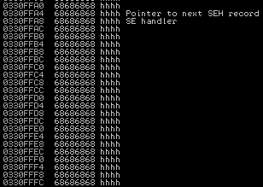
Case Study - MYSQL
MYSQL < =5.1.41 COM_FIELD_LIST
Stack overflow
Supply a long field name as the parameter

Slide 40
SafeSEH
No modules to be used
No useable memory addresses
Can’t fall back to ret overwrite due to /GS
Try a longer string?
Maybe a different code path is taken

Slide 41
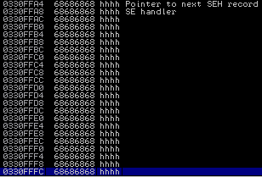
Something's Different
Different AV
Different Code Location

Slide 42
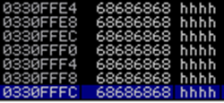
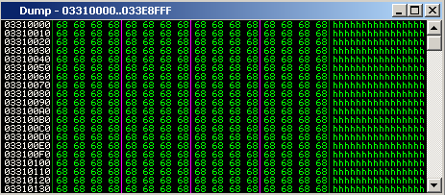
Memory Map
Stack
No Guard Page

Slide 43
Neg EIP
Interesting
Doesn’t help us bypass SafeSEH restritions
Wonder what this other memory is?
If only we could stop the current thread from crashing

Slide 44
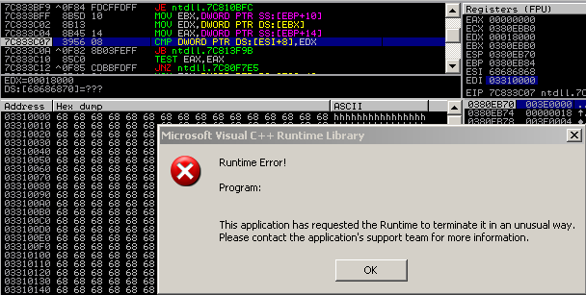
Looks Like Heap Code

Slide 45
Heap Segment Header Exploitation
Heap segment
Created when heap is extended
Pointer stored in base heap
40 byte chunk contains
Heap chunk header
Segment metadata
Segment header queried
During allocation for large size
Segment queried on uncommitted memory
Will commit and insert new chunk into freelist[0]
Heap Management
Address | Description
003E0000 | Base Address
003E0058 | Segments[64]

Slide 46
Heap Segment Header Exploitation
Heap Segment Header
Address | Value | Description
03310008 | FFEEFFEE | Signature
0331000C | 00000000 | Flags
03310010 | 003E0000 | Heap
03310014 |  | LargestUnCommittedRange
03310018 | 03310000 | Base Address
0331001C | 00000400 | Number of pages
03310020 | 03310040 | First Entry
03310024 | 03FF0371 | Last Valid Entry
03310028 |  | NumberOfUnCommittedPages
0331002C |  | NumberOfUnCommittedRanges
03310030 | 003E0588 | UnCommittedRanges
03310034 | 00000000 | AllocatorBackTraceIndex
03310036 | 00000000 | Reserved
03310038 | 03310040 | LastEntryInSegment
40 Byte Chunk
Heap Management
Address
Description
003E0000
Base Address
003E0058
Segments[64]
Address for newly created chunk to use
UnCommittedRanges
Address | Description
+0 | Flags/# pages
+4 | Chunk Address
+8 | Chunk Size

Slide 47
Heap Segment Header Exploitation
Exploit needs to setup
FirstEntry pointer
UnCommittedRange (this controls the returned address)
UnCommittedRange
UnCommittedRange
Range Address

Slide 48
More Heaps
At next large allocation
Fake uncommittedrange used
01ACBA90 is returned
Data written to allocated buffer
Overwritten function pointer table in MYSQL heap

Slide 49
EIP FTW
Function table accessed
EAX points to our data
00446914 MOV EAX,DWORD PTR DS:[ESI] 00446916 MOV EDX,DWORD PTR DS:[EAX+4] 00446919 PUSH EDI 0044691A PUSH EBX 0044691B PUSH EBP 0044691C PUSH ECX 0044691D MOV ECX,ESI 0044691F CALL EDX
The 2nd RET address
The address for EDX
Take control of the stack
00424983 PUSH EAX 00424984 POP ESP 00424985 RETN
00401054 POP ECX 00401055 RETN

Slide 50
Bypass DEP
Use VirtualAlloc call from within MYSQL
Return to a JMP ESP
Crafty stack setup

Slide 51
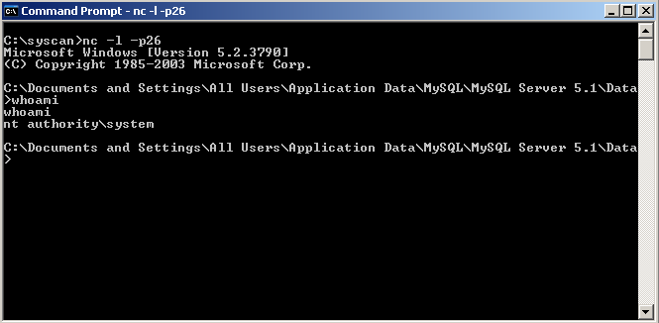
Profit

Slide 52
www.insomniasec.com

